Slide 1
Chapter 2 Basic Structures: Sets, Functions, Sequences, Sums, and Matrices
Section 2.1 :Sets

Slide 2
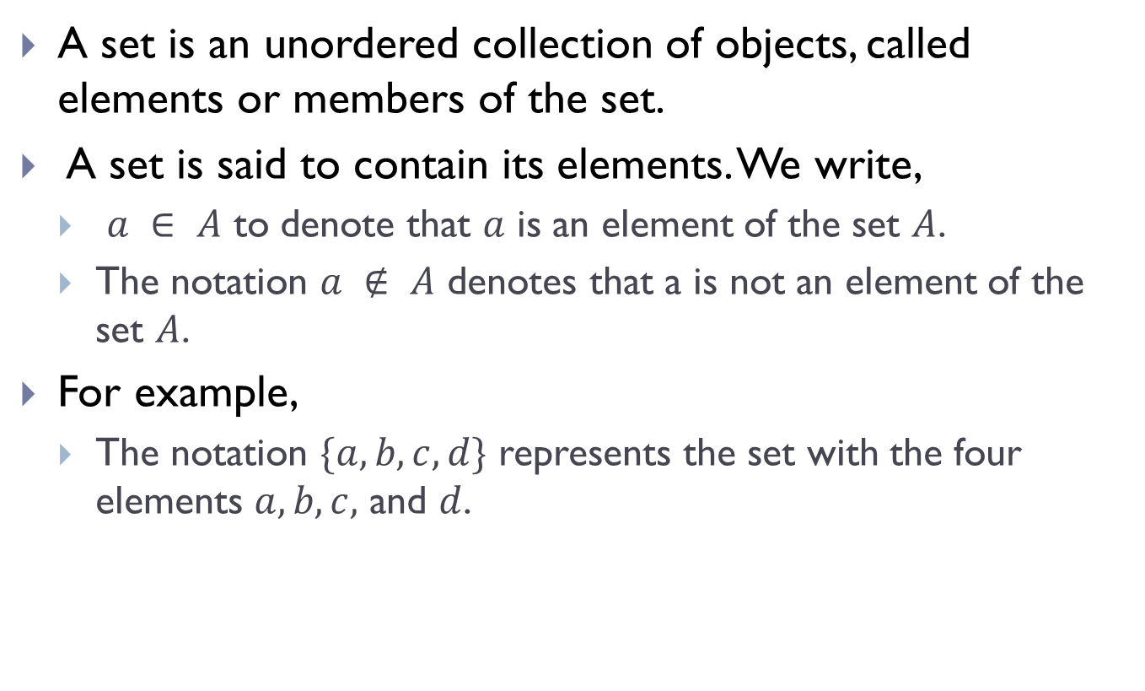
Sets
A set is an unordered collection of objects, called elements or members of the set.
A set is said to contain its elements. We write,
$a ∈ A$ to denote that $a$ is an element of the set $A$.
The notation $a ∉ A$ denotes that a is not an element of the set $A$.
For example,
The notation $\{a, b, c, d\}$ represents the set with the four elements $a, b, c,$ and $d$.

Slide 3
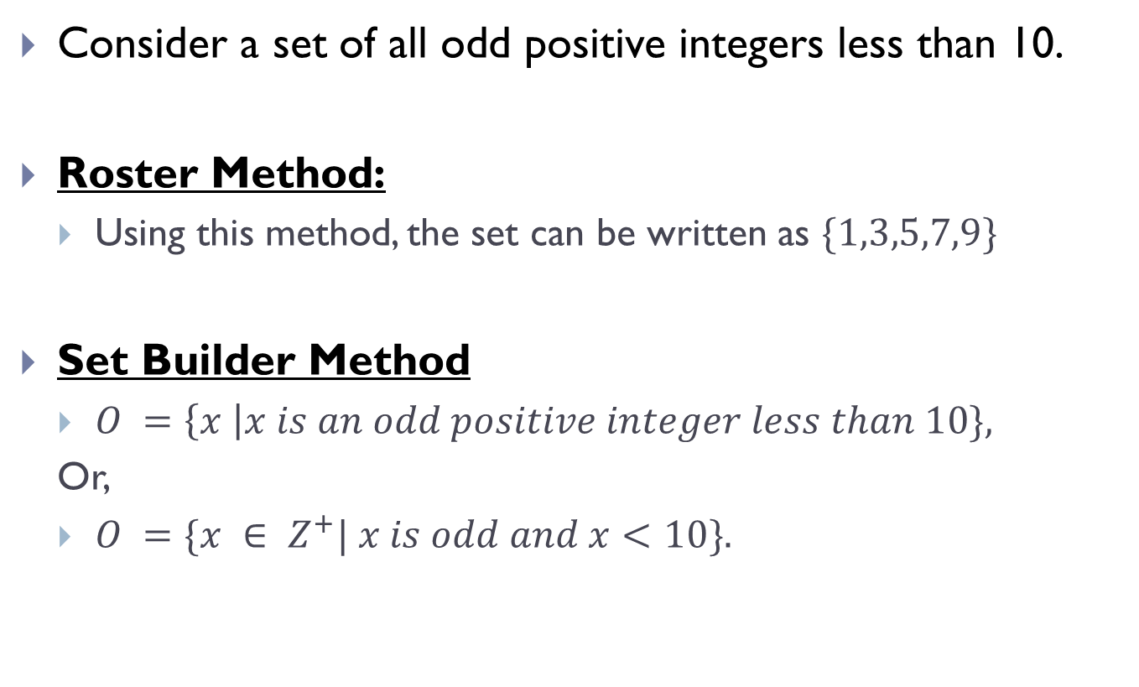
Sets(Contd.)
Consider a set of all odd positive integers less than 10.
Roster Method:
Using this method, the set can be written as $\{1,3,5,7,9\}$
Set Builder Method
$O =\left\{x \right|x is an odd positive integer less than 10\},$
Or,
$O =\{x ∈ Z^{+}| x is odd and x<10\}.$

Slide 4
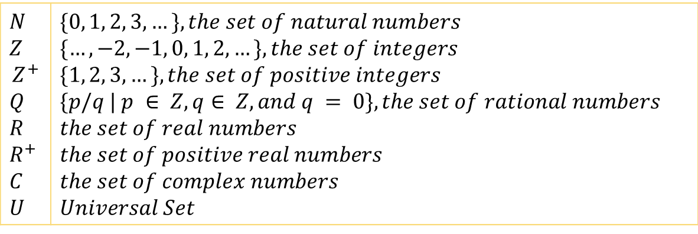
Sets(Contd.)
Few common notations
$N$ $Z$ $$Z^{+}$$ $Q$ $R$ $R^{+}$ $C$ $U$ | $\{0, 1, 2, 3,…\}, the set of natural numbers$ $\{…,−2, −1, 0, 1, 2,…\}, the set of integers$ $\{1, 2, 3,…\}, the set of positive integers$ $\{p/q | p ∈ Z,q∈ Z, and q = 0\}, the set of rational numbers$ $the set of real numbers$ $the set of positive real numbers$ $the set of complex numbers$ $Universal Set$

Slide 5
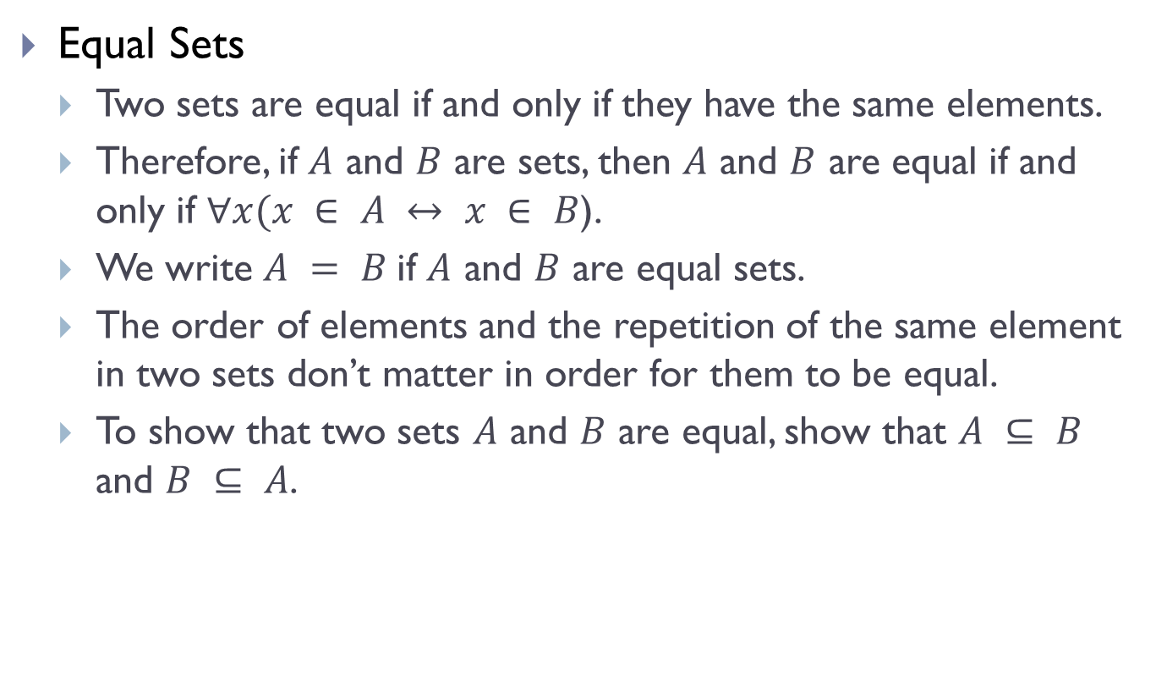
Equal Sets
Equal Sets
Two sets are equal if and only if they have the same elements.
Therefore, if $A$ and $B$ are sets, then $A$ and $B$ are equal if and only if $∀x(x ∈ A ↔ x ∈ B$).
We write $A = B$if $A$ and $B$ are equal sets.
The order of elements and the repetition of the same element in two sets don’t matter in order for them to be equal.
To show that two sets $A$ and $B$ are equal, show that $A ⊆ B$ and $B ⊆ A$.

Slide 6

Equal Sets(Contd.)
Example 1:
The sets $\left\{1, 3, 5\right\}$and $\left\{3, 5, 1\right\}$are equal, because they have the same elements.
Similarly, the sets $\{1, 3, 5\}$and $\{3, 5, 5, 5, 5, 1\}$are equal, because they have the same elements.

Slide 7
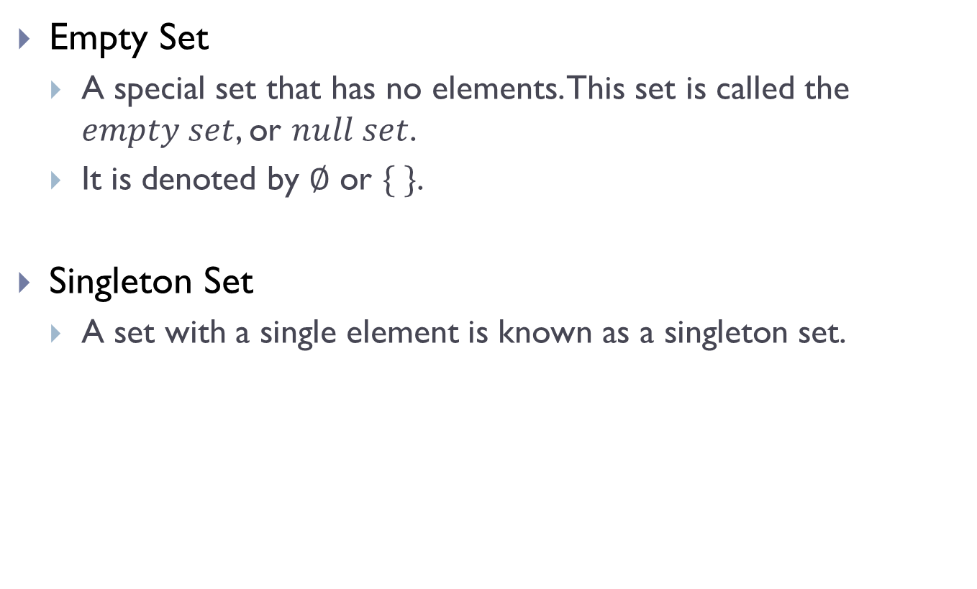
Empty & Singleton Sets
Empty Set
A special set that has no elements. This set is called the $empty set$, or $null set$.
It is denoted by $∅$ or $\{ \}$.
Singleton Set
A set with a single element is known as a singleton set.

Slide 8

Empty & Singleton Sets(Contd.)
$$But WAIT!!!$$

Slide 9

Empty & Singleton Sets(Contd.)
Let, $A= \{ \}$ and $B=\{∅\}$. Are both the sets empty?
The Answer is $NO.$
Because set $B$ has an element which is the empty element itself. Thus, $B$ is a singleton set and not an empty set.

Slide 10
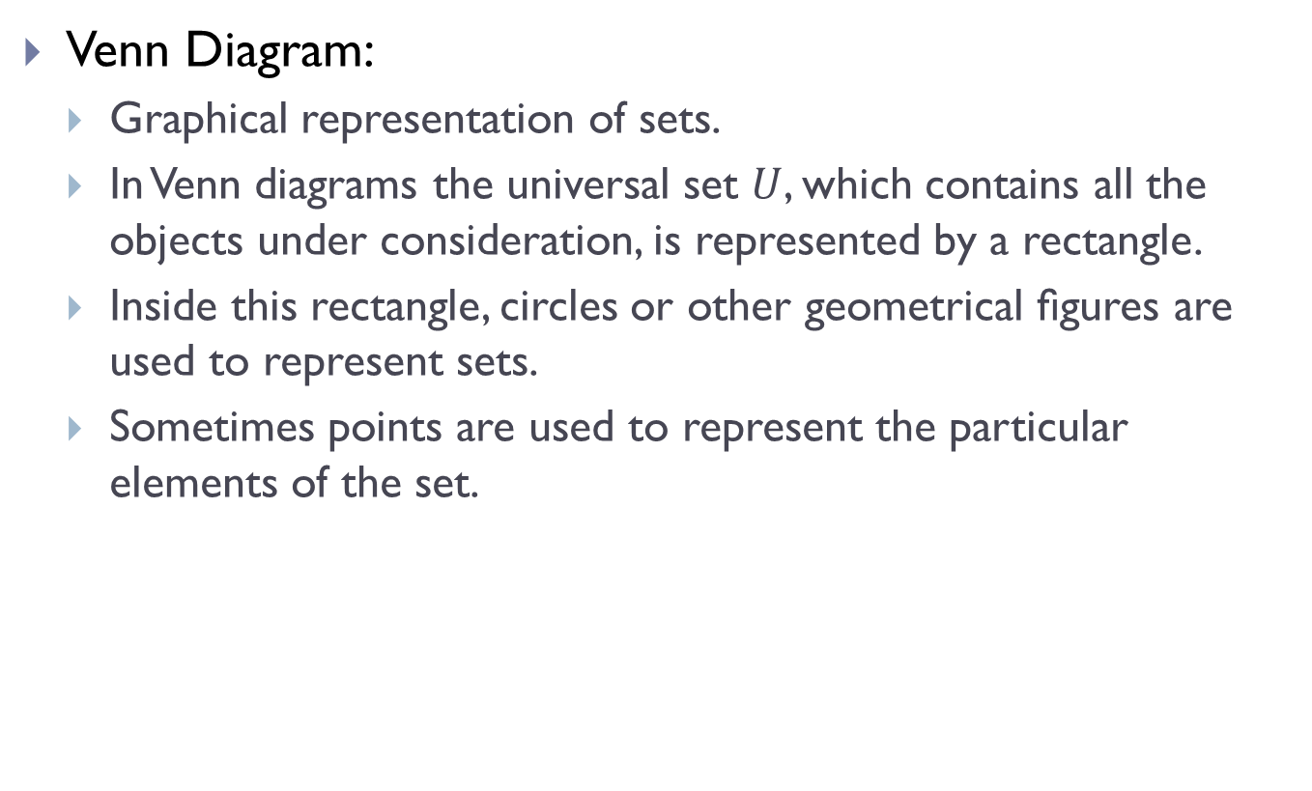
Venn Diagram
Venn Diagram:
Graphical representation of sets.
In Venn diagrams the universal set $U$, which contains all the objects under consideration, is represented by a rectangle.
Inside this rectangle, circles or other geometrical ﬁgures are used to represent sets.
Sometimes points are used to represent the particular elements of the set.

Slide 11
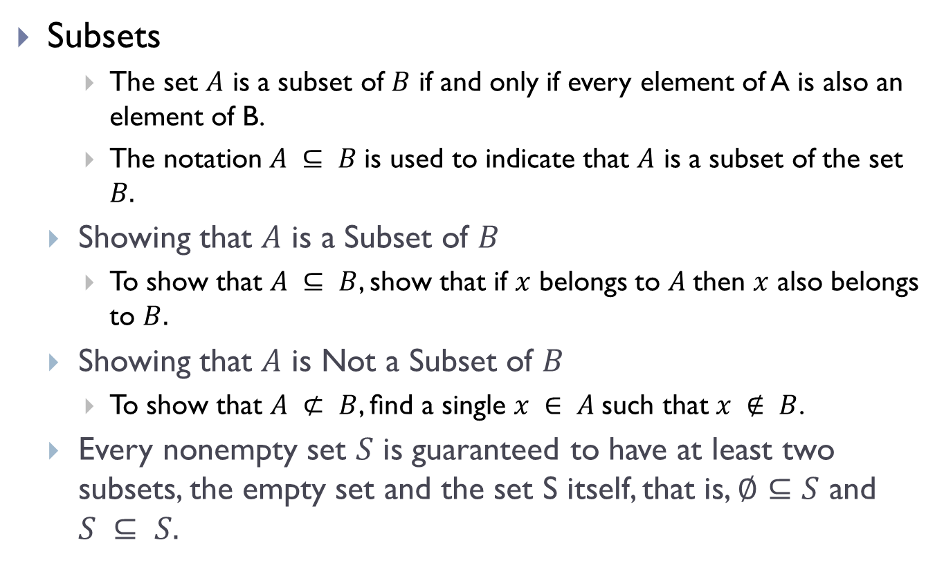
Subsets
Subsets
The set $A$ is a subset of $B$ if and only if every element of A is also an element of B.
The notation $A ⊆ B$is used to indicate that $A$ is a subset of the set $B.$
Showing that $A$ is a Subset of $B$
To show that $A ⊆ B$, show that if $x$ belongs to $A$then $x$ also belongs to $B.$
Showing that $A$ is Not a Subset of $B$
To show that $A ⊄ B$, ﬁnd a single $x ∈ A$such that $x ∉ B$.
Every nonempty set $S$ is guaranteed to have at least two subsets, the empty set and the set S itself, that is, $∅⊆S$ and $S ⊆ S.$

Slide 12
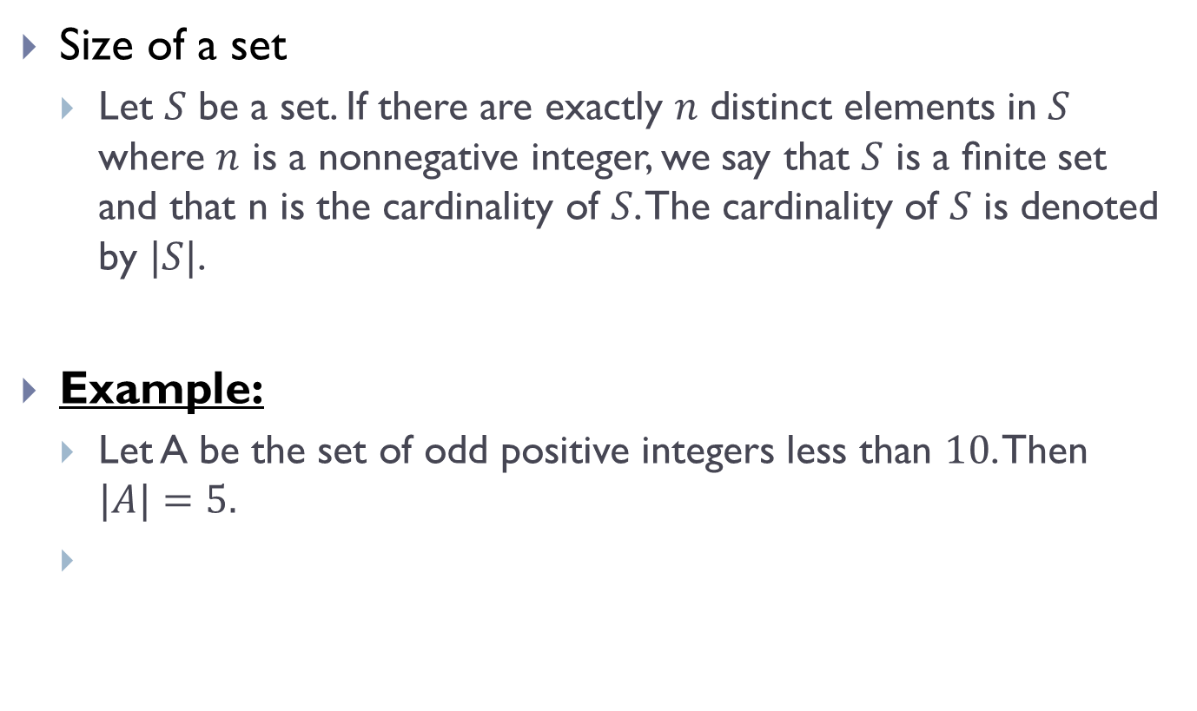
Cardinality
Size of a set
Let $S$ be a set. If there are exactly $n$ distinct elements in $S$ where $n$ is a nonnegative integer, we say that $S$ is a ﬁnite set and that n is the cardinality of $S$. The cardinality of $S$ is denoted by $|S|$.
Example:
Let A be the set of odd positive integers less than $10$. Then $|A|=5.$

Slide 13
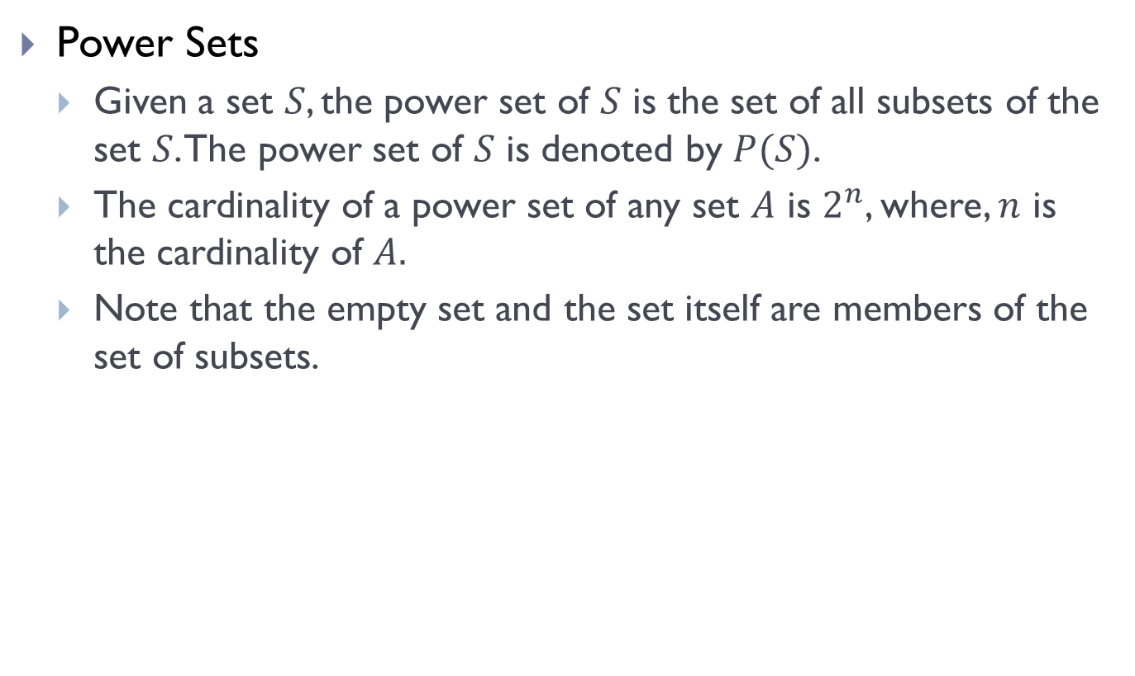
Power Sets
Power Sets
Given a set $S$, the power set of $S$ is the set of all subsets of the set $S$. The power set of $S$ is denoted by $P(S)$.
The cardinality of a power set of any set $A$ is $2^{n}$, where, $n$ is the cardinality of $A.$
Note that the empty set and the set itself are members of the set of subsets.

Slide 14
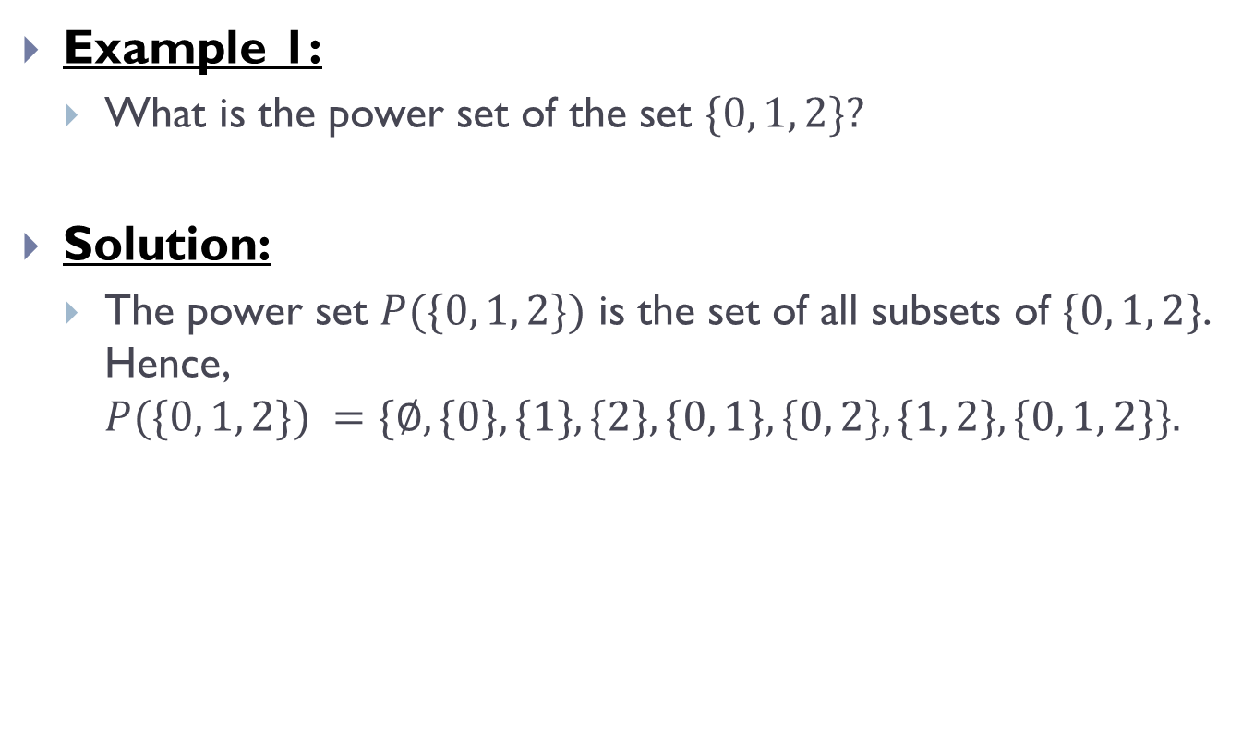
Power Sets(Contd.)
Example 1:
What is the power set of the set $\{0, 1, 2\}?$
Solution:
The power set $P(\{0, 1, 2\})$ is the set of all subsets of $\{0, 1, 2\}$. Hence, $P(\{0, 1, 2\}) =\{∅, \{0\}, \{1\}, \{2\}, \{0, 1\}, \{0, 2\}, \{1, 2\}, \{0, 1, 2\}\}.$

Slide 15
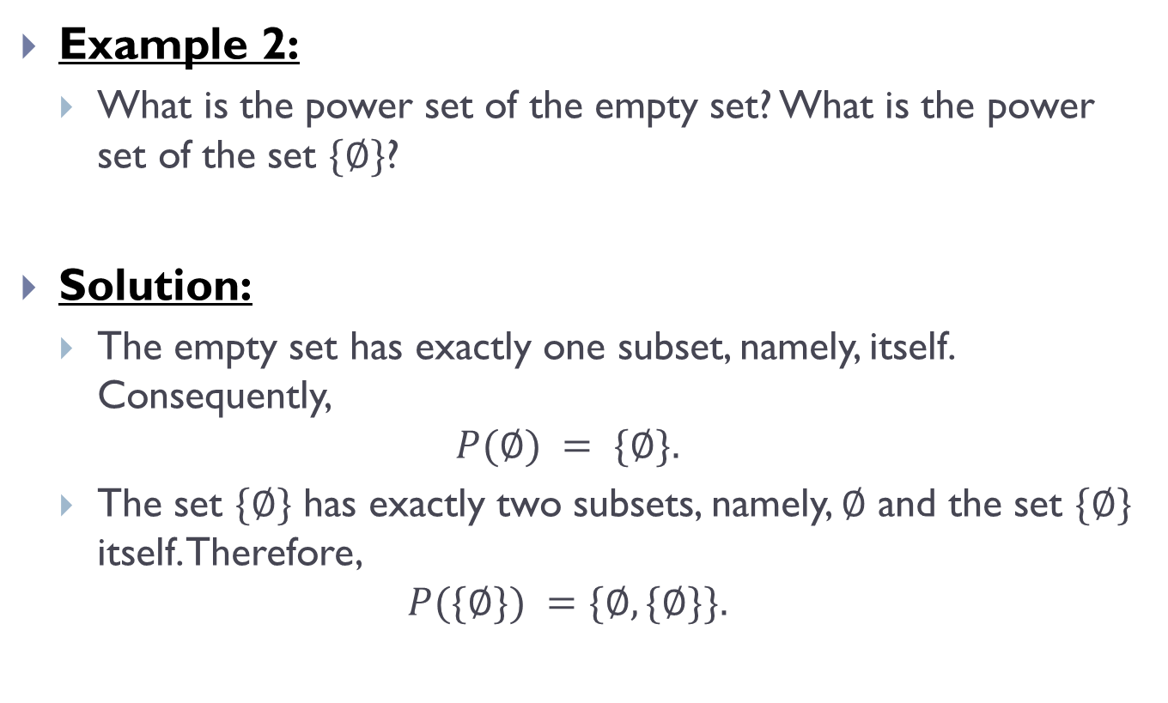
Power Sets(Contd.)
Example 2:
What is the power set of the empty set? What is the power set of the set $\{∅\}$?
Solution:
The empty set has exactly one subset, namely, itself. Consequently,
$$P(∅) = \{∅\}.$$
The set $\{∅\}$ has exactly two subsets, namely, $∅$ and the set $\{∅\}$ itself. Therefore,
$$P(\{∅\}) =\{∅, \{∅\}\}.$$

Slide 16
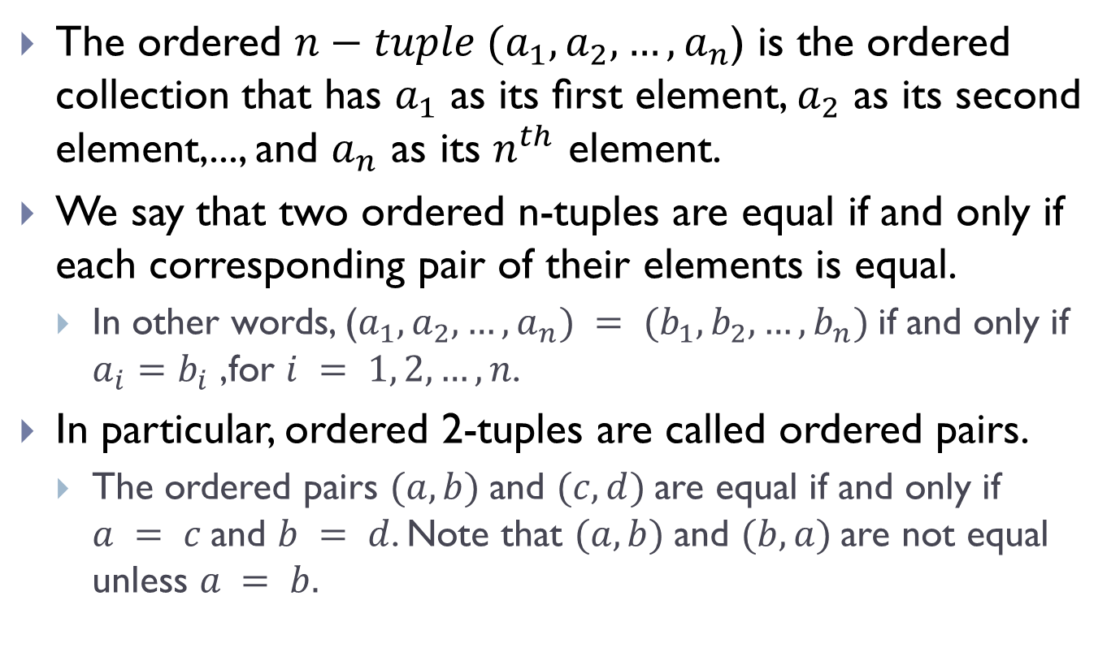
Ordered Pairs
The ordered $n−tuple (a_{1},a_{2},…,a_{n}$) is the ordered collection that has $a_{1}$ as its ﬁrst element, $a_{2}$ as its second element,..., and $a_{n}$ as its $n^{th}$ element.
We say that two ordered n-tuples are equal if and only if each corresponding pair of their elements is equal.
In other words, ($a_{1},a_{2},…,a_{n}) = (b_{1},b_{2},…,b_{n})$if and only if $a_{i}=b_{i}$ ,for $i = 1, 2,…,n$.
In particular, ordered 2-tuples are called ordered pairs.
The ordered pairs $(a, b)$and $(c, d)$are equal if and only if $a = c$and $b = d$. Note that $(a, b)$and $(b, a)$are not equal unless $a = b.$

Slide 17
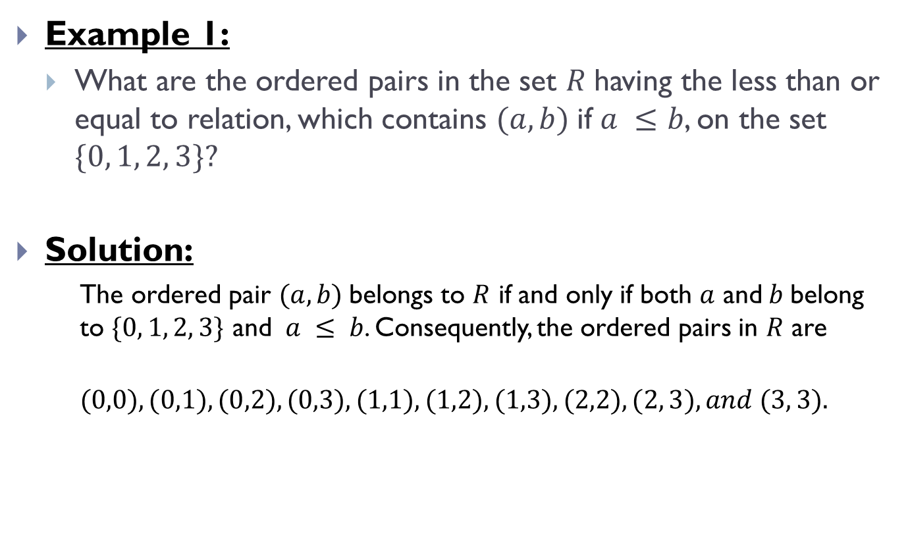
Ordered Pairs(Contd.)
Example 1:
What are the ordered pairs in the set $R$having the less than or equal to relation, which contains $(a, b)$if $a ≤b$, on the set $\{0, 1, 2, 3\}?$
Solution:
The ordered pair $(a, b)$belongs to $R$ if and only if both $a$ and$b$belong to $\{0, 1, 2, 3\}$ and $a ≤ b$. Consequently, the ordered pairs in $R$ are
$$(0,0), (0,1), (0,2), (0,3), (1,1), (1,2), (1,3),(2,2), (2, 3), and (3, 3).$$

Slide 18
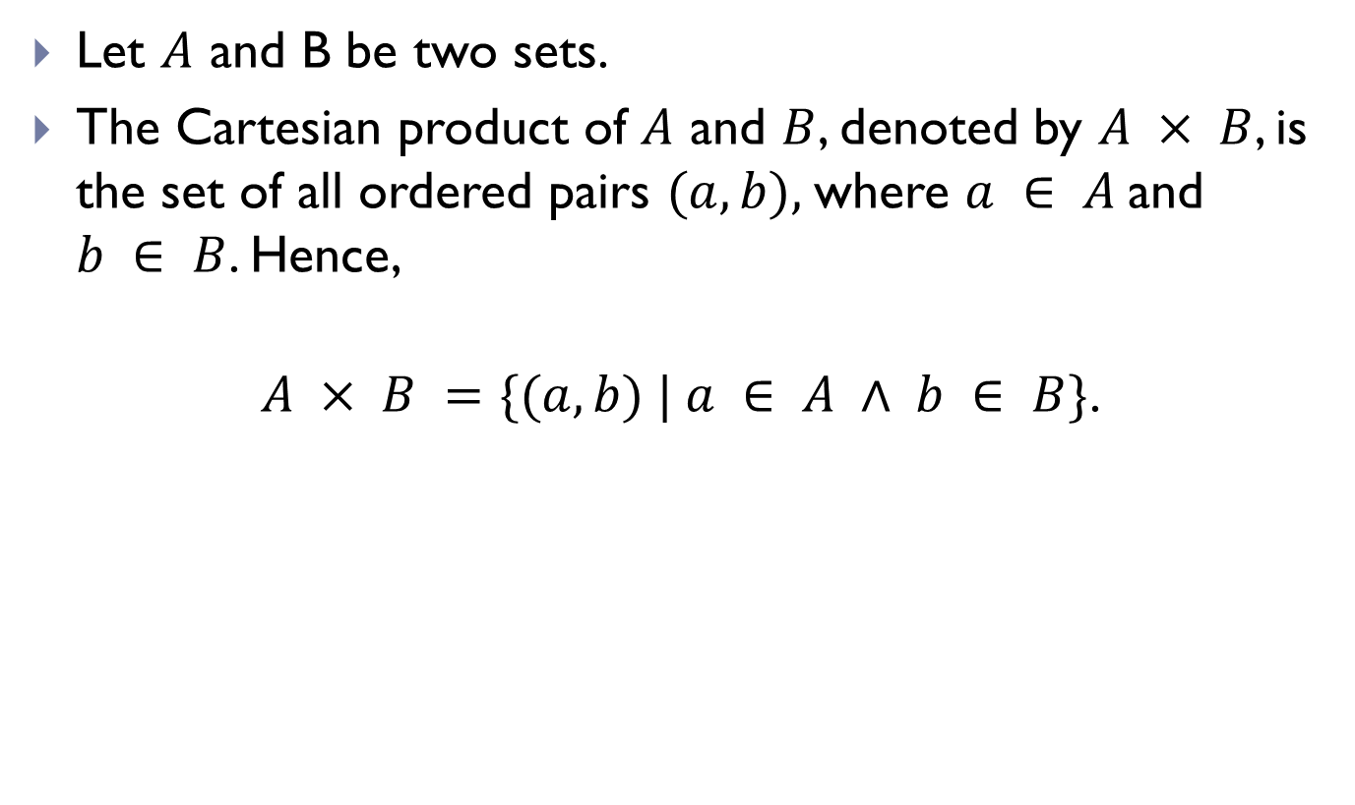
Cartesian Products
Let $A$ and B be two sets.
The Cartesian product of $A$ and $B$, denoted by $A × B$, is the set of all ordered pairs $(a, b),$where $a ∈ A$and $b ∈ B$. Hence,
$$A × B =\{(a, b) | a ∈ A ∧ b ∈ B\}\text{.}$$

Slide 19
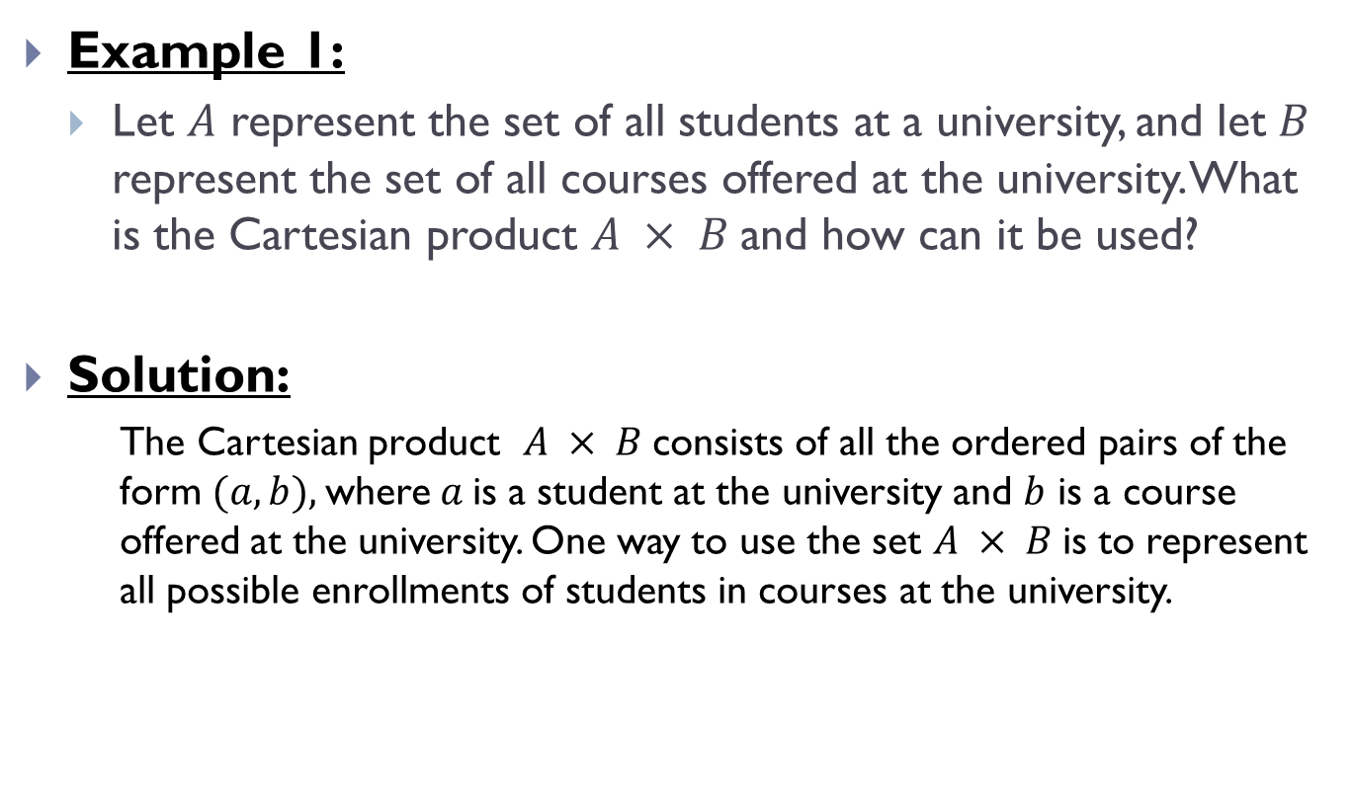
Cartesian Products(Contd.)
Example 1:
Let $A$ represent the set of all students at a university, and let $B$ represent the set of all courses offered at the university. What is the Cartesian product $A × B$and how can it be used?
Solution:
The Cartesian product $A × B$consists of all the ordered pairs of the form $(a, b),$where$a$is a student at the university and $b$ is a course offered at the university. One way to use the set $A × B$is to represent all possible enrollments of students in courses at the university.

Slide 20
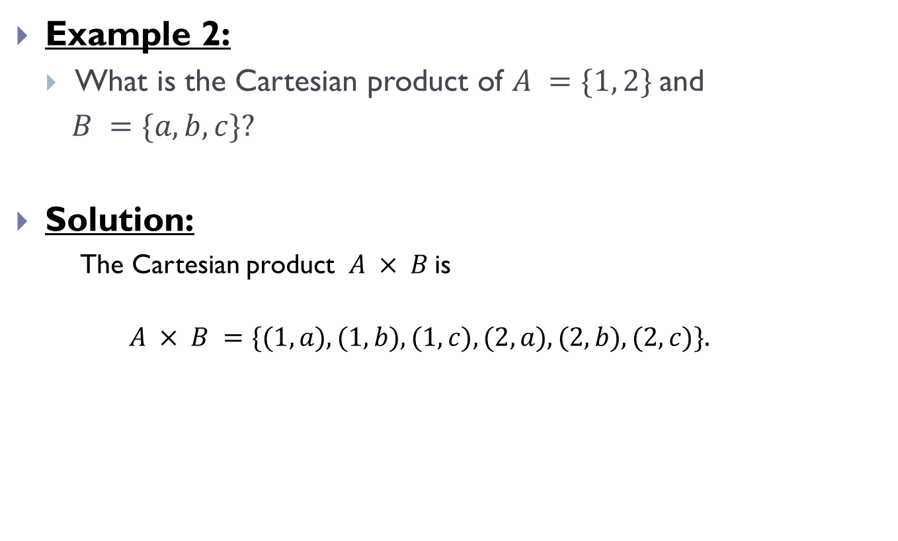
Cartesian Products(Contd.)
Example 2:
What is the Cartesian product of $A =\{1, 2\}$and
$B =\{a, b, c\}?$
Solution:
The Cartesian product $A × B$is
$$A × B =\{(1, a), (1, b), (1, c), (2, a), (2, b), (2,c)\}.$$

Slide 21
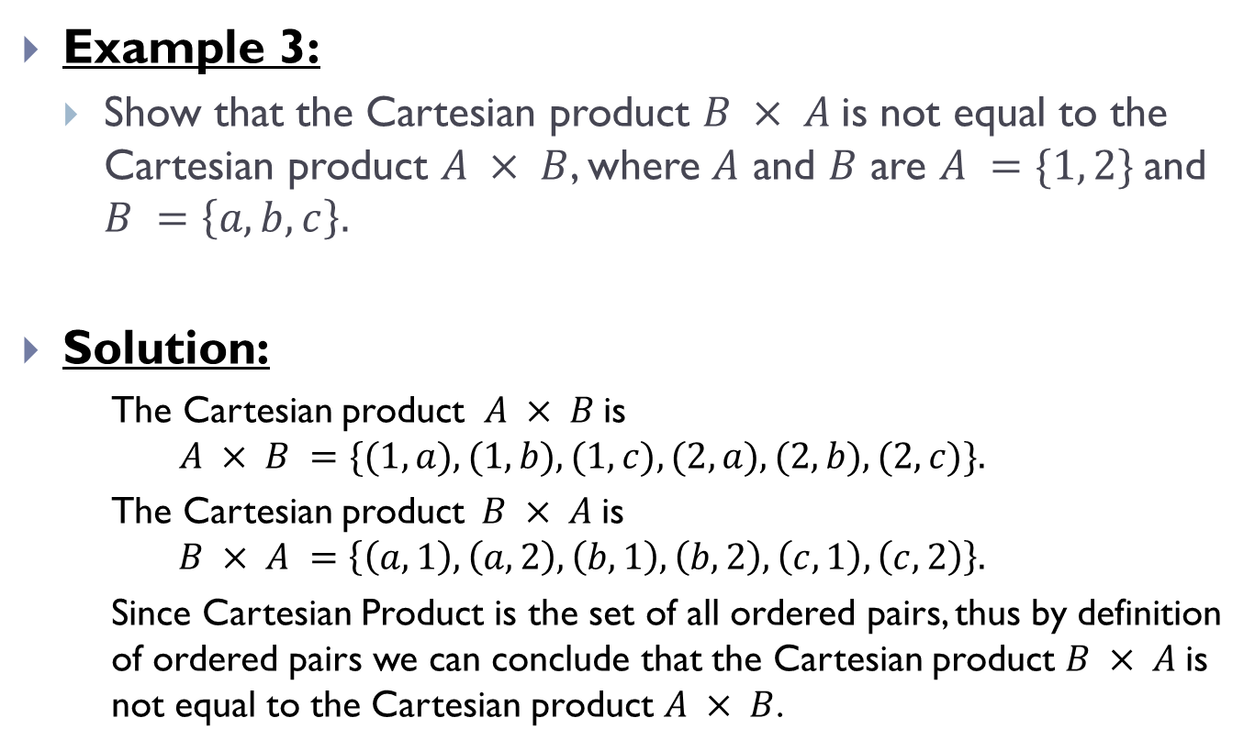
Cartesian Products(Contd.)
Example 3:
Show that the Cartesian product $B × A$is not equal to the Cartesian product $A × B$, where $A$ and $B$ are $A =\{1, 2\}$and $B =\left\{a, b, c\right\}.$
Solution:
The Cartesian product $A × B$is
$$A × B =\{(1, a), (1, b), (1, c), (2, a), (2, b), (2,c)\}.$$
The Cartesian product$B × A$is
$$B × A =\left\{\left(a, 1\right), \left(a, 2\right), \left(b, 1\right), \left(b, 2\right), \left(c, 1\right), \left(c, 2\right)\right\}.$$
Since Cartesian Product is the set of all ordered pairs, thus by definition of ordered pairs we can conclude that the Cartesian product $B × A$is not equal to the Cartesian product $A × B$.

Slide 22
THE END

